Slide 1

Team members:
Sunitha
Soundharya
Sridevi
Srilakshmi
Srinitha

Slide 2
Main Modules
Website accessibility Functionality
Registration Functionality
Login Functionality
Search Functionality
Product Functionality
Watchlist Functionality
Sell Product functionality

Slide 3
Project Description
An eBay Store allows user to shop various products from various country.
Customers can even purchase secondhand products from Ebay.
Ebay also provide the extra feature like sell your products which mean customer can sell their products by creating the seller account.

Slide 4
Roles of testers:
Website accessibility Functionality - Soundharya
Registration Functionality - Soundharya
Login Functionality - Sunitha
Search Functionality - Sri Lakshmi
Product Functionality – Sri devi
Watchlist Functionality - Srinitha
Sell Product functionality - Sridevi

Slide 5
Process of testing
User stories
Requirements
Test Scenarios
Test Cases
Defect report
Traceability Matrix
Test summary report

Slide 6

SPRINT PLAN:
Writing the epics
Writing the user stories
Executing user stories in JIRA
Writing the Test scenarios
Writing the requirement
Writing the test cases
Writing the defect report
Executing defect in JIRA
Traceability Matrix
Testcase Summary Report

Slide 7
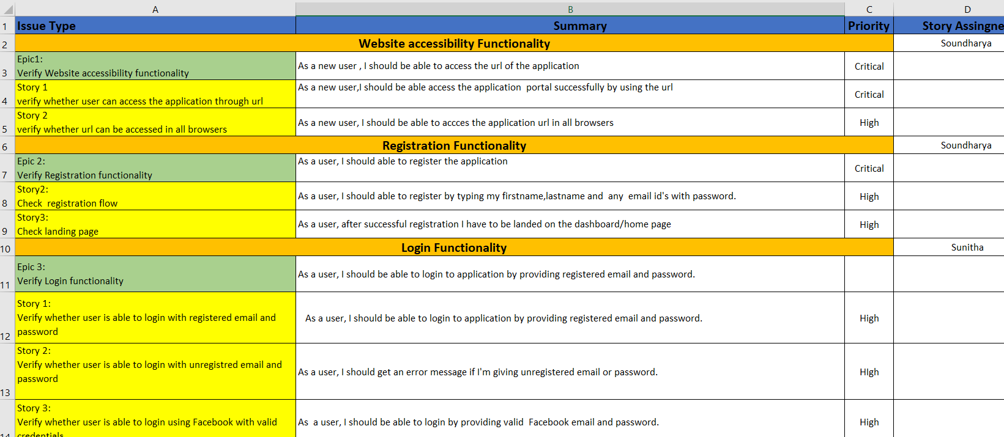
USER STORIES

Slide 8
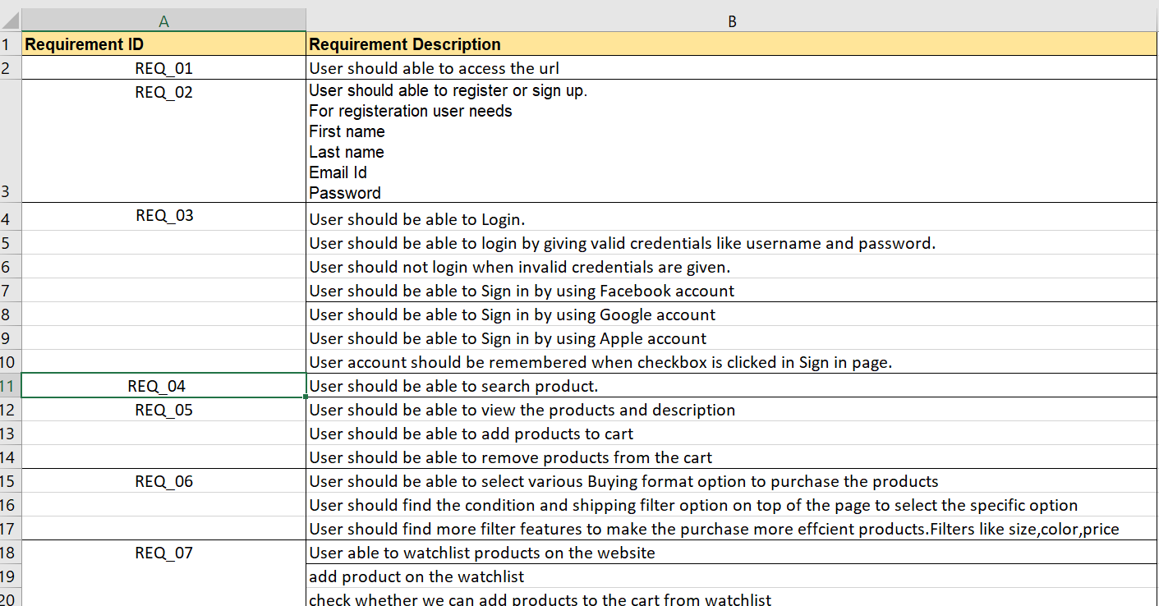
REQUIREMENTS

Slide 9
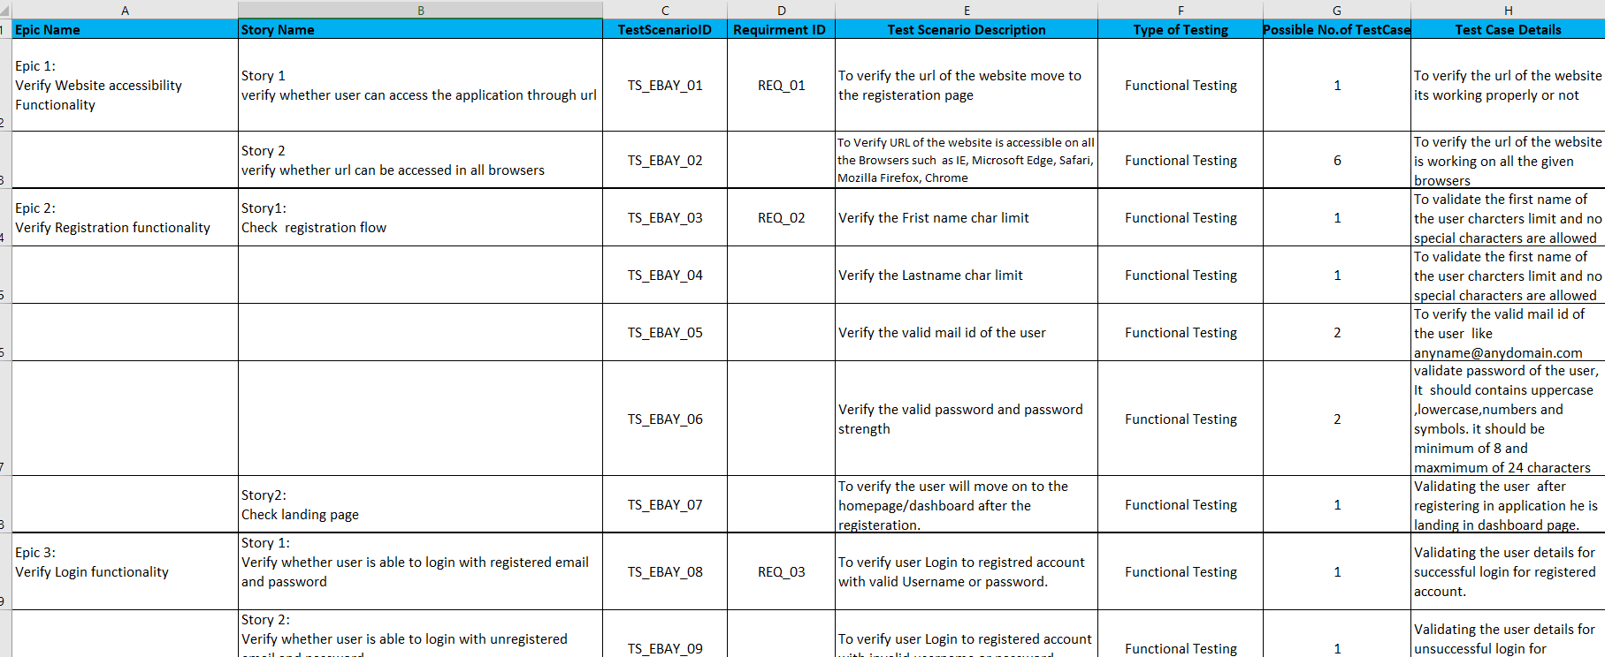
TEST SCENARIOS

Slide 10
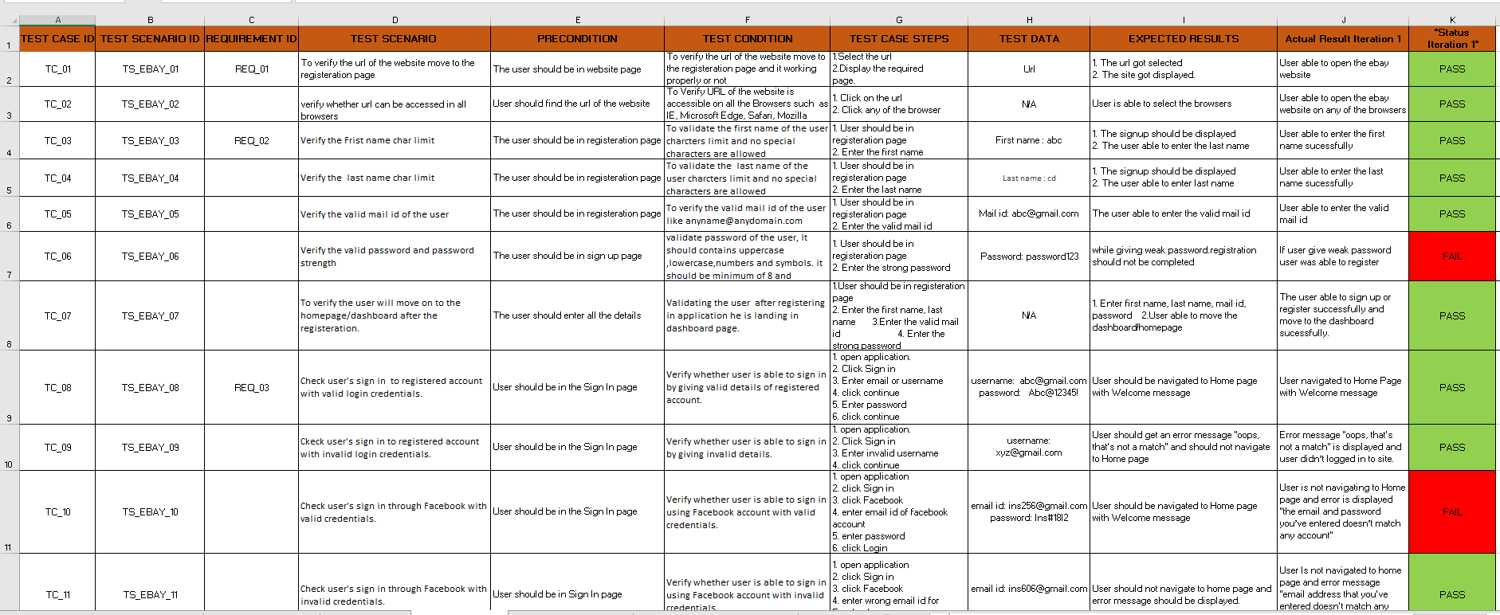
TEST CASES

Slide 11
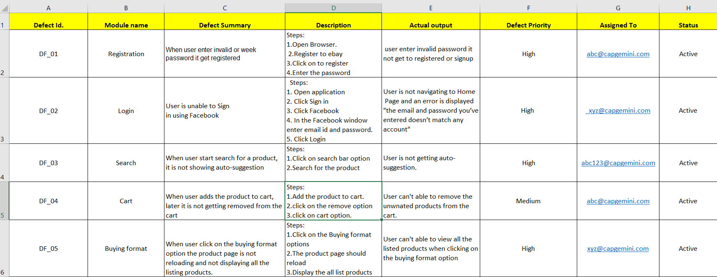
DEFECTS REPORT

Slide 12
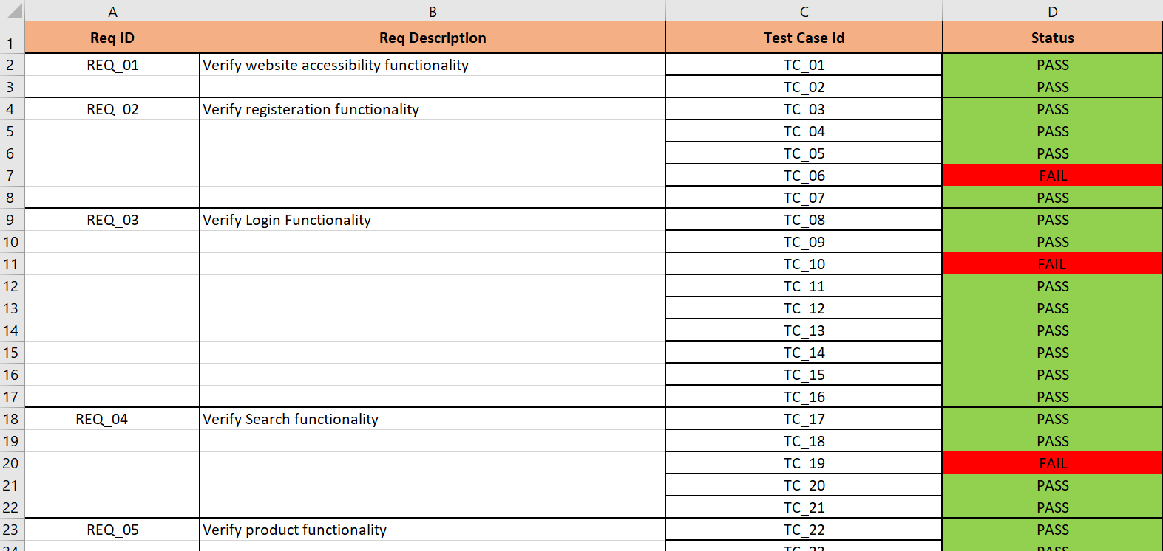
TRACEABILITY MATRIX

Slide 13
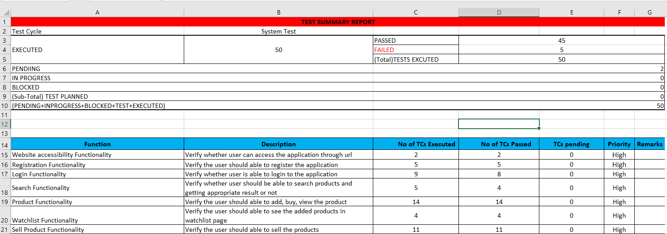
TEST SUMMARY REPORT

Slide 14
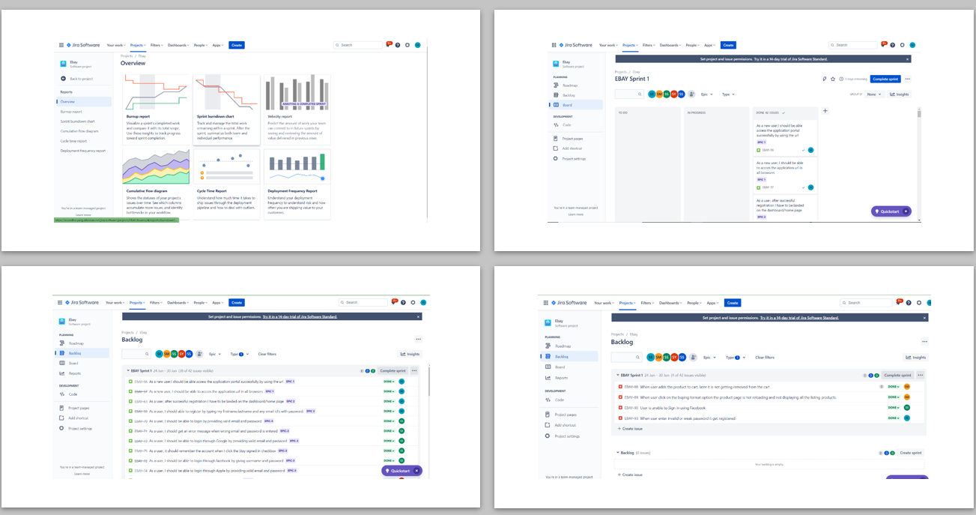
JIRA REPORT

Slide 15
Challenges faced:
Initially we had faced difficulties in handling the JIRA like how to add epic user stories and defects.
We had faced some challenges with adding more the test cases and finally we find some way to overcome this issues.

Slide 16

THANK YOU

